Slide 1
Grief: A Spectrum of Loss and a Variety of Ways to Work Through
Stephanie Larson,
MSW, LICSW, LCSW

Slide 2
Objectives
Gain a better understanding of the spectrum of grief and loss
Define types of grief and loss
Review DSM-TR criteria for Prolonged Grief Disorder and differentiate from other applicable disorders
Gain confidence in supporting clients through grief and loss
Discuss some interventions for grief and best ways to support those dealing with loss
O

Slide 3
About Me and My Why
What is your why?

Slide 4
Loss
The absence of an important person, place, or thing.
“The fact or process of losing something or someone.”
Loss does not have to be tangible.

Slide 5
Mourning
“The expression of deep sorrow for someone who has died…”
The action or outward visible and symbolic expression of grief
Applies to all forms of loss
Often culturally and spiritually influenced

Slide 6
Grief
The emotional experience that is the result of loss.
“Deep sorrow, especially caused by someone’s death.”
Typically associated with the loss of person...
…but what else can we grieve?

Slide 7
Common Types of Grief and Loss
Not valued or recognized by others
Normal Grief
Typically lasts 6 months to 2 years
Follows social, cultural and religious/spiritual norms
Delayed Grief
Anticipatory Grief
The felt sense and process PRIOR to the loss event
Loss that occurs without closure or clear understanding
Lacks resolution, verification or certainty
Leaves the bereaved searching for answers
Disenfranchised Grief
Ambiguous Loss
Considered unacceptable or invalidated by social, cultural or religious/spiritual norms
Hidden or shameful grief
The delayed onset of grief post loss event
Typically brought on by another big event or loss and/or a complex loss event or grief situation
Can be more difficult than the post-event processing
Eterneva.com, 2023

Slide 8
What We Are Told Grief Looks Like
Resolution and grief ends
Denial
Anger
Bargaining
Depression
Acceptance
Loss
Event
12 Months Post Loss Event

Slide 9
What Grief Actually Looks Like

Slide 10
The 6 Needs of Mourning
1. Acknowledge the Reality that Someone has Died
2. Befriend the Pain of Loss
3. Remember the Person Who has Died
4. Develop a New Sense of Identity
5. Search for Meaning in the Loss
6. Have Ongoing Support Long After the Death
(Wolfelt, 2023)

Slide 11
Kessler’s Finding Meaning – The Sixth Stage of Grief
Meaning happens within the griever, not in the event
Is not a bypass to the pain
Meaning puts a mark on the fact that the loss mattered and the life before the loss mattered
“A cushion to the pain” – Kessler
Beyond having a compassionate, present, witness; this is perhaps the most important part of the process

Slide 12
You don’t have to get over it; but you can get through it.
“
”

Slide 13
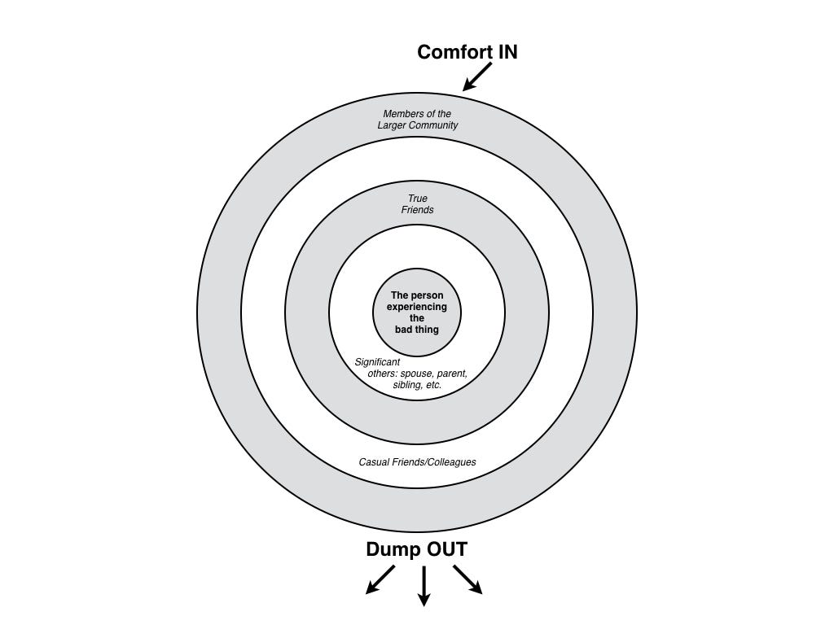
Circles of Support

Slide 14
How to Support Someone through Grief and Loss
Just show up
No fixing, just offers
Make a meal, help with a chore/pet/childcare
Call, send a card, or text
Ask “What is this like for you?”
Allow for good days/moments
Remind the griever to treat self as best friend
Remember, grief does not define the person, simply a process they are going through
Do not define the loss for the griever
Give the griever permission for feedback and/or non-response
Encourage continued connection with the loss*
Count the wins
Normalize the pitfalls
Support group that is cohesive
Faith/Spirituality
Community/Circles of Support
What has helped you in the past – keeping in mind your role and what layer of the circle you are in

Slide 15
Continued…
Letter to/from the deceased/source of loss
Talk with the deceased/about the loss with trusted persons
Encourage connection to another with similar loss outside center of the circle
Books
Art/Music
Daily Meditation/Interpretation of event
Social Media
Tell Your Story and Learn Other’s Stories
Memorial/Honor Events:
Fundraiser
Annual gathering
Candle ceremony/Holding vigil
Fire ceremony
Travel
New traditions
Favorite foods/things

Slide 16
Harmful
Helpful

Slide 17
Potentially Destructive
Assumptions
Prescriptive plan for “getting better”
Expectations
Timelines
Comparisons
Grief Ranking
Shame
Judgement
Dismissiveness
Ignoring

Slide 18
PGD Diagnostic Criteria
C. Since death, at least 3 Sx have been present most days to a clinically significant degree; and occurred nearly every day for last month:
Identity disruption
Marked sense of disbelief about the death
Avoidance of reminders
Intense emotional pain related to the death
Difficulty reintegrating into relationships and activities
Emotional numbness
Feeling that life is meaningless
Intense loneliness
D. Significant distress or impairment in social, occupational, or other functioning.
E. Duration and severity of the bereavement reaction CLEARLY exceed expected social, cultural or religious norms for the individuals’ culture and context.
F. The Sx are not better explained by another mental disorder, such as MDD, PTSD, and are not attributable to the psychological effects of a substance.
A. Death > 12 months of a person close to the bereaved (> 6 mo for children and adolescents)
B. Development of persistent grief response with 1 or both of the following symptoms, present most days, to a clinically significant degree.; and the Sx has occurred nearly every day for at least the last month.:
Intense yearning for the deceased person
Preoccupation w/ Thoughts or memories of the deceased person. * In children and adolescents, preoccupation may focus on the circumstances of the death.

Slide 20
R
Resources
Handouts
Books

Slide 21
Thank you
Stephanie Larson, MSW, LICSW, LCSW

Slide 22
References
Academy of Therapy Wisdom. (n.d.). What Does It Mean to Grieve: Recovering from Loss. 2022.
Grief.com. (2023, March 29). Retrieved from Help for Grief Because Love Never Dies: https://grief.com/
Hanson, W. (1997). The Next Place. Minneapolis: Waldman House Press, Inc.
Hickman, M. (1994). Healing After Loss: daily meditations for working through grief. New York: HarperCollins.
Kessler, D. (2019). Finding Meaning. New York: Scribner.
Kessler, D. (2020, March 31). Grief and Finding Meaning. (B. Brown, Interviewer)
Kessler, D. (2021, 12 22). Interventions for Dealing with Unattended Grief. PESI.
Kubler- Ross M.D., E. (1969). On Death and Dying. Simon & Schuster.
Kubler-Ross, M. &. (2005). On Grief and Grieving. New York: Scribner.
Schweibert, P. &. (n.d.). Tear Soup: A Recipe for Healing After Loss. Portland: Grief Watch.
Wallace, T. (2023, March 29). 16 Types of Grief: When They Happen and What They Mean. Retrieved from Eterneva: https://www.eterneva.com/resources/types-of-grief
Wolfelt, A. (2023, October 9). The 6 Needs of Mourning. Retrieved from Funeral Basics: https://www.funeralbasics.org/the-6-needs-of-mourning/
Zuba, T. (2014). Permission to Mourn. Rockford: Bish Press.

