Slide 1
Navigating Complex Healthcare Systems
October 22, 2023 Marjorie Schaffer, PhD, RN

Slide 2
Agenda
Mental health care system barriers
Overcoming barriers
Advocacy strategies

Slide 3
About me . . .
Professor of Nursing Emerita - Bethel University
Family to Family teacher for National Alliance on Mental Illness
Hennepin County Adult Mental Health Advisory Council (6 years)
Ambassador with Mental Health Connect and All Saints Lutheran Church
Parent of an adult daughter living with bipolar disorder
Author of Journey Through the Mental Illness Maze: How Families Find Hope and Acceptance

Slide 4
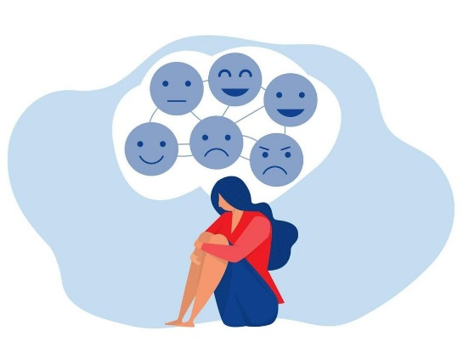
My Story
My daughter lives with bipolar disorder
For my daughter - repeated episodes and hospitalizations for over 20 years
For me - Crisis….Coping….Advocacy
Acceptance
System challenges – staff changes, finding housing
Finding my voice and using it
My daughter is living well

Slide 5
Barriers to Good Mental Healthcare
Stigma/discrimination
Poor communication skills of mental health staff
Inadequate information sharing
Health information privacy rules
Lack of clarity about role
Lack of patient and family education
Non-involvement of caregiver in treatment plan

Slide 6
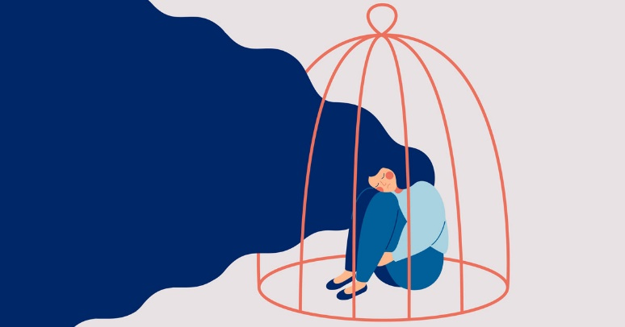
Negative Impact of Stigma/Discrimination
Reluctance to seek help, which results in delayed treatment
Isolation due to a lack of understanding
Reduced opportunities for employment, school, social activities, and housing
Bullying or harassment
Inadequate health insurance for covering treatment
The belief that the situation cannot be improved
Mayo Clinic, 2017

Slide 7
Family Experience of Stigma/Discrimination
They told me, “Connie, you gave this to Naomi.” Laura [Naomi’s sister] told me, “It’s your blood line; it’s genetic. Thanks for putting the crazy gene in me. Now who’s going to want to marry me because I have a crazy sister. . .There is a genetic marker and that comes from you. This is from your family. Your family is weak.”

Slide 8
Discouraging Messages from Mental Health Providers and Staff
Lived experience is not relevant
People diagnosed with a psychosis-related disorder have no hope for recovery
Sharing and discussing professional knowledge is not necessary
Ansalem et al., 2018

Slide 9
Barrier: Challenging Language
Connie (mother of Naomi)
They’re talking to you, but until you understand language, it can feel like they’re talking at you. You’re under stress already. It’s not an ideal time to be learning a second language on mental health and legal. I felt like I was running as fast as I can, [but it’s] like walking through Jello or concrete that is starting to harden.

Slide 10
Barrier: Care is Discontinued
Anita (mother of Serena and Nina)
What I didn’t like was that they dropped her when she was doing well. This is a roller coaster. The system is so frustrating.

Slide 11
Barrier: Communication Challenges
Jim (husband of Monica)
I don’t think they communicate with the family members as much as they do with the patient themselves. So even though it’s a one on one with the patient, the patient kind of has an idea of what’s going on, but we’re still left out in the dark.
Communication Challenges

Slide 12
Barrier: Ignored by Staff
Brenda (wife of Don)
I said, “I have asked you guys for information. Nobody will call me. Nobody will talk to me. Now you are going to discharge him, now you want me to step in? I need to know what meds he’s on, what side effects to look for, and nobody will call me back.”
Melanie (daughter of Gordon)
Somebody to talk to that didn’t judge you because even family…As a kid, I internalized a lot and thought maybe something was wrong with me. Then I didn’t know any better. Just somebody to talk to I think was the biggest part—to know your feelings are justified and you can have them and it doesn’t mean you did anything good or bad.

Slide 13
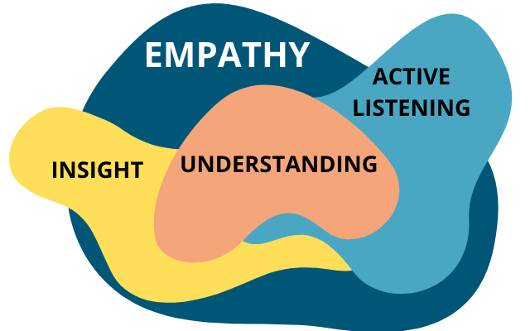
What Helps: Presence/Empathy
Sharon (mother of Gabrielle)
I remember this one nurse who came in at night time. She sat on my daughter’s bed and she was just really straightforward about it and talked about the benefits of a treatment and what’s realistic, including the negative side effects. We both really appreciated that. She was straight about it but kind. It felt really respectful. My daughter had all the information she needed to make a decision on whether that was going to be good for her.

Slide 14
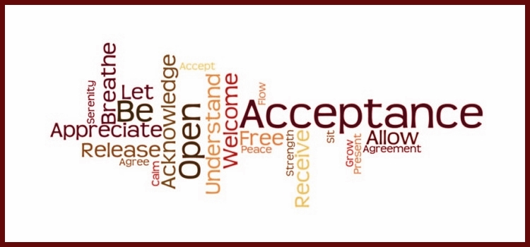
Overcoming Barriers Reduce Stigma and Discrimination in Mental Health
Learn facts about mental illness and share them (normalize).
Get to know people who have personal experiences; focus on the person rather than the illness (promotes acceptance).
Treat all people with respect and dignity; avoid judging and labelling.
Use person-first language.

Slide 15
Overcoming Barriers Reduce Stigma and Discrimination in Mental Health
Challenge or confront inaccurate or stereotypical comments about mental illness.
Resist letting harmful comments influence your own self-talk.
Share your own experience as someone who lives with a mental illness or as a family member.
Develop resilience, a protective factor that reduces the harmful effects of stigma and discrimination.

Slide 16
Overcoming Barriers Education
Benefits of mental health education for families
Reduced burden
Increased knowledge of diagnosis and treatment
Improved ability to cope
Increased life satisfaction
Ability to provide more effective care for their relative
Coker et al., 2016; Ewertson & Hanson, 2019; Hsiao et al., 2022

Slide 17
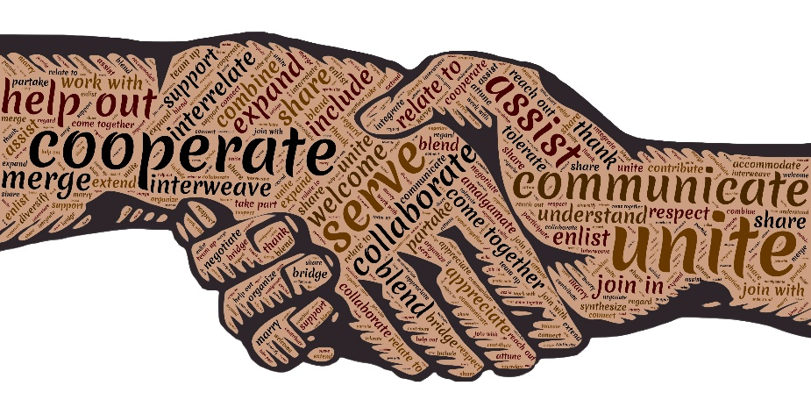
Overcoming Barriers What Health Professionals Can Do
Explain health information privacy rules
Provide information about mental health support groups and education
Give attention to perspectives of patient and family members
Provide clear information about treatment plan and what to expect
Include patient and family in decision-making about plan of care
Communicate a respectful, caring approach that promotes a safe environment

Slide 18
Family Experience: Juanita’s Story
What barriers did you face in trying to help your son get good mental health treatment?
What did you do to overcome those barriers?
How do you advocate for your son and others who live with a mental illness?

Slide 19
Benefits of Advocacy for Mental Health
For Consumers
Greater hopefulness
Improved quality of life
Fewer psychiatric symptoms
Sense of personhood
For Family Members
Reduction in distress
Increased problem solving and coping skills
Positive self-appraisal
Increased knowledge and sense of empowerment
Jonikas et al., 2013; Lucksted et al., 2013; Toohey et al., 2016

Slide 20
When to Advocate
Lack of attention to an individual’s mental health history
Treatment is based on a standard with little attention given to individual uniqueness
Communication of diagnosis conveys an expectation of outcomes
Individuals are not informed about treatment options or included in decisions about their treatment
When mental health services and resources are low quality and not based on evidence

Slide 21
Advocacy: Speak Up About Mental Health
“Having the word ‘advocacy’ – to advocate for someone. Just knowing that helped. Because I’m not being the bitchy mom. I’m not being the controlling parent. I’m advocating for what’s in the best interest of my child.”
Connie

Slide 22
Advocacy Normalizing Mental Illness
Sam (son of Miriam)
She was my mom who made goulash way too many times every week. I hate goulash. Well, it’s mostly tomatoes. Just think stewed tomatoes with a cupful of other things. . .Her favorite color was purple. Every spring she would plant some pink flowers and purple flowers. She liked Alfred Hitchcock movies and she had bipolar. So that is how I see the world. It’s a characteristic.

Slide 23
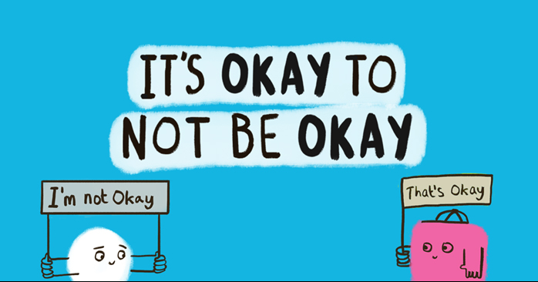
Advocacy Raising Awareness
Sharon (mother of Gabrielle)
I wear this “Make it Ok” button. I wear it everywhere because one in five Americans live with mental illness. When we get access to care, we get better. So, stop the silence. I have my daughter’s permission to share her name.
Notes:
.

Slide 24
Advocacy Actions
Safeguarding – protecting from harm that may result from symptoms or treatment
Apprising – give truthful and relevant information about diagnosis and treatment alternatives
Valuing – honor preferences and choices by supporting autonomy, listening, and affirming
Mediating – Bring attention of mental healthcare team to their needs
Championing social justice – responding to unfair situations such as lack of access and resources
Abbasinia et al., 2020

Slide 25
Mental Health Connect: Advocating for Mental Health
Collaborate with faith communities
Educate - mental health resources
Navigate
Video: MHC Navigator - Russell O’Brien
“Reaching out to a Navigator is free, individualized, and confidential. MHC navigators help remove barriers and complexity so that you can gain access to the right providers or resources for your unique situation.” https://www.mhconnect.org/

Slide 26
Small Group Discussion
Describe a barrier experienced in trying to access good mental health care.
What are possible actions for responding to that barrier?
What could you do to advocate for getting effective mental health services?

Slide 27
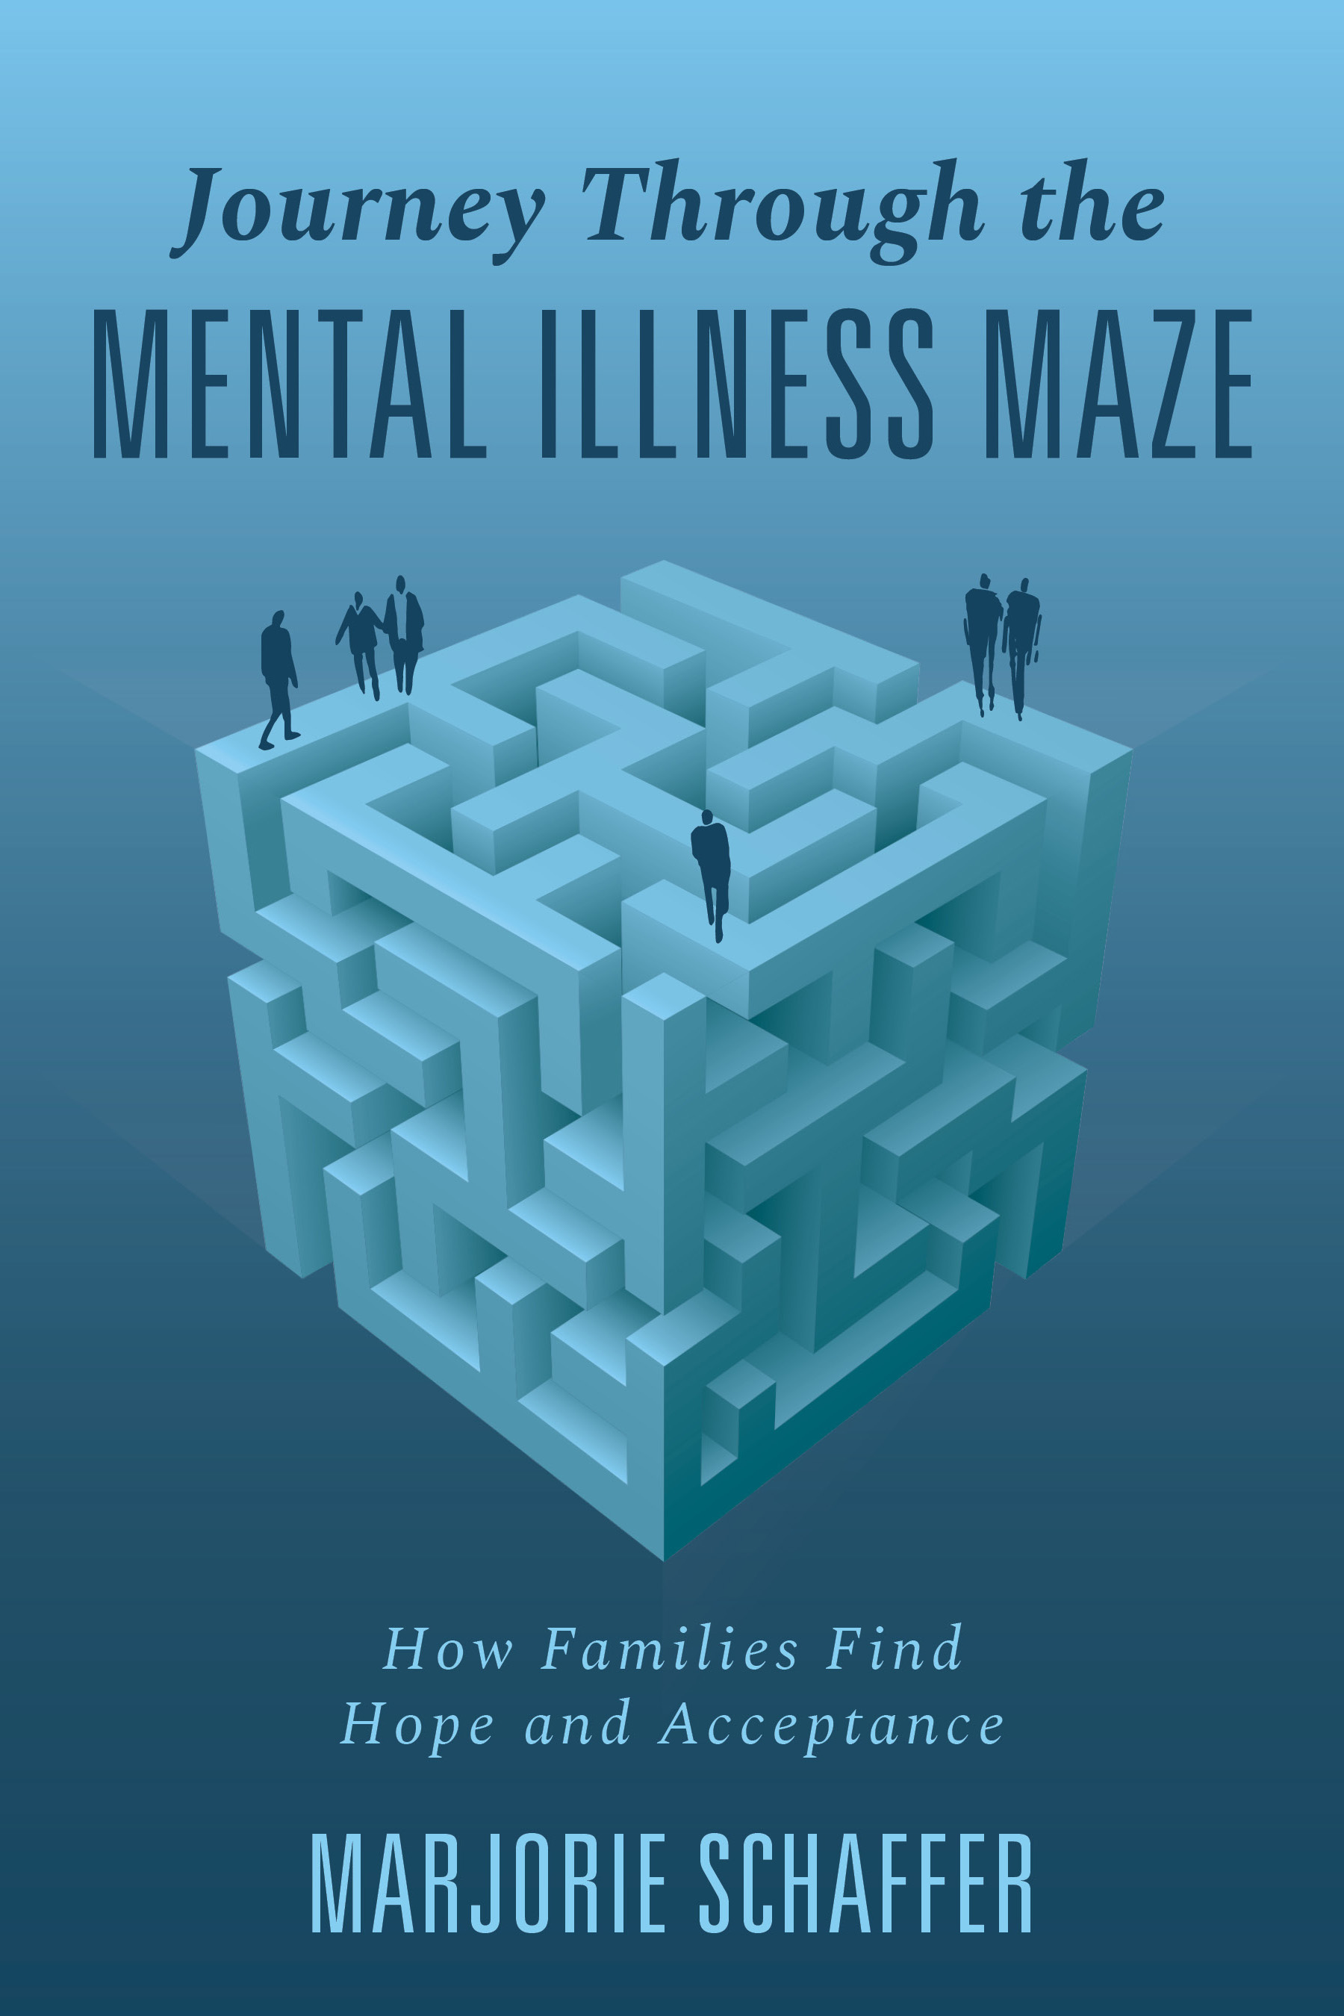
Publications
Website: Family Stories of Bipolar Disorder
Two articles
Family Perspectives of Healthcare for Relatives Living with a Mental Illness
Speaking Up: How Family Members Advocate for Relatives Living with a Mental Illness
Book
Journey Through the Mental Illness Maze: How Families Find Hope and Acceptance

Slide 28
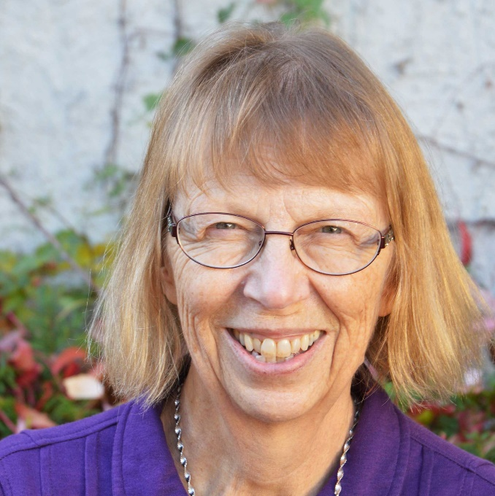
Contact Information
Email m-schaffer@bethel.edu
Website Family stories of bipolar disorder

